Slide 1


Hubert Kalaus
5.11.2024

Slide 2

Outline
Executive Summary
Introduction
Methodology
Results
Conclusion
Appendix

Slide 3
Executive Summary
Summary of methodologies
Data Collection through API
Data Collection with Web Scraping
Data Wrangling
Exploratory Data Analysis with SQL
Exploratory Data Analysis with Data Visualization
Interactive Visual Analytics with Folium & Dash
Machine Learning Prediction
Summary of all results
Exploratory Data Analysis results
Interactive analytics screenshots
Predictive Analytics result

Slide 4
Introduction
Project background and context
Commercial space age: space travel becomes accessible
Through: cost-effective SpaceX launches with reusable Falcon 9 rockets.
Reusability of Falcon 9’s first stage significantly reduces launch costs.
Problems you want to find answers
Explore launch data, identify key contributors to success
Project goal: Develop a model to predict SpaceX first stage reusability for Space Y, a new competitor.

Slide 5

Section 1

Slide 6
Methodology
Executive Summary
Data collection methodology:
Flight data from the SpaceX Rest API
additional information from wikipedia
Perform data wrangling
JSON objects and html tables were converted to Pandas dataframes
Perform exploratory data analysis (EDA) using visualization and SQL
Perform interactive visual analytics using Folium and Plotly Dash
Perform predictive analysis using classification models
Evaluation of machine learning models to predict Falcon 9 lauch success

Slide 7
Data Collection
Flight data was collected from the SpaceX Rest API and Wikipedia pages
SpaceX REST API
Past launch data via requests as JSON object
JSON object converted to dataframe
Final Pandas dataframe
Web scraping launch records from Wikipedia
Convert webpage data using BeautifulSoup
Export soup data as dataframe

Slide 8
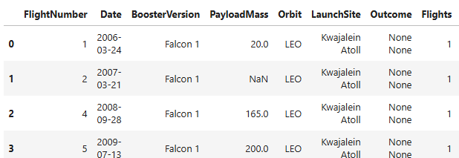
Data Collection – SpaceX API
SpaceX REST API
Launch data in JSON format
Launch data obtained from SpaceX REST API
Converted to Pandas dataframe via JSON object
GitHub Link: https://github.com/Javert15/Final-Data-Science-Coursera-project/blob/main/jupyter-labs-spacex-data-collection-api.ipynb
Launch data in Pandas dataframe
…
…

Slide 9
Data Collection - Scraping
Launch data for Falcon 9 flights available on Wikipedia
Web scraped using BeautifulSoup for further processing
GitHub Link: https://github.com/Javert15/Final-Data-Science-Coursera-project/blob/main/jupyter-labs-webscraping.ipynb
Wikipeda page on Falcon 9 launches
Html data as BeautifulSoup object
Falcon 9 Launch data in Pandas dataframe

Slide 10
Data Wrangling
First, the missing values were identified
GitHub Link: https://github.com/Javert15/Final-Data-Science-Coursera-project/blob/main/labs-jupyter-spacex-Data%20wrangling.ipynb
Identification of missing values
Control of correct data types
Determined launches per site, targeted orbit and mission outcome
Introduced landing outcome label „Class“

Slide 11
EDA with Data Visualization
Summarize what charts were plotted and why you used those charts
Categorial plot of Flight Number for each Lanch Site
Categorial plot of Payload Mass for each Lanch Site
Bar chart of Success Rate for each targeted Orbit type
Scatterplot of targeted Orbit for each Flight number, with indication of success
Scatterplot of targeted Orbit for each Payload Mass, with indication of success
Lineplot of Success Rate per year
GitHub Link: https://github.com/Javert15/Final-Data-Science-Coursera-project/blob/main/edadataviz.ipynb

Slide 12
EDA with SQL
Summary of SQL queries performed:
Selected distinct Launch Sites
Investigated the initial 5 launches from CCAFS LC-40
Calculated total masscarried by boosters launched by NASA and F9
Identified the initial successful landing
Identified the Boosters that achieved successful landing in a drone ship with a payload mass between 4000 and 6000 kg
Identified the Booster versions, that carried the maximum payload
Listed records for months in 2015
Counted the Successes and Failures between 2010-06-04 and 2017-03-20
GitHub Link: https://github.com/Javert15/Final-Data-Science-Coursera-project/blob/main/jupyter-labs-eda-sql-coursera_sqllite.ipynb

Slide 13
Build an Interactive Map with Folium
Markers were added to the locations of launch sites
Later, additional markers were added, to indicate the success of the missions from the respective launch sites
In turn, lines were drawn to indicate the distance to the nearest coast, railway etc. to show the launch sites’ proximity to these locations
GitHub Link: https://github.com/Javert15/Final-Data-Science-Coursera-project/blob/main/lab_jupyter_launch_site_location.ipynb

Slide 14
Build a Dashboard with Plotly Dash
A Dashboard was used to visualize the success rate from different launch sites and with different payloads
The success rate is visualized using a pie chart, where the overall success rates and the success rates for individual sites can be compared
The payload scatter plot allows to select a range for the payload of interest and indicates whether these missions were successful or not
GitHub Link: https://github.com/Javert15/Final-Data-Science-Coursera-project/blob/main/spacex_dash_app.py

Slide 15
Predictive Analysis (Classification)
Summarize how you built, evaluated, improved, and found the best performing classification model
You need present your model development process using key phrases and flowchart
Add the GitHub URL of your completed predictive analysis lab, as an external reference and peer-review purpose

Slide 16
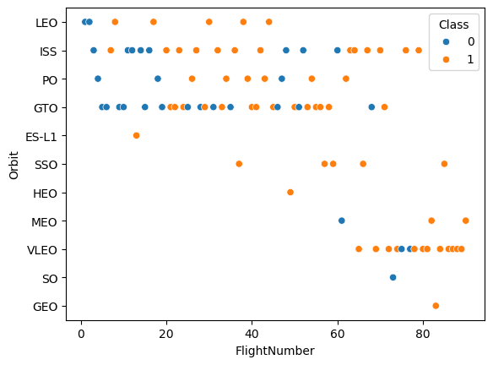
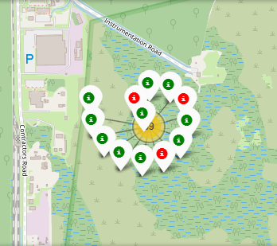
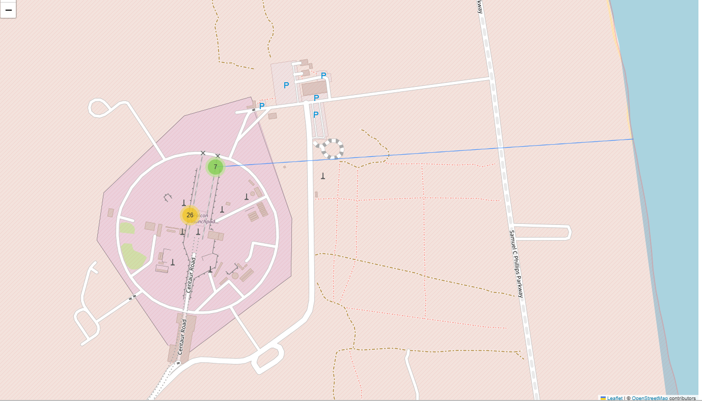
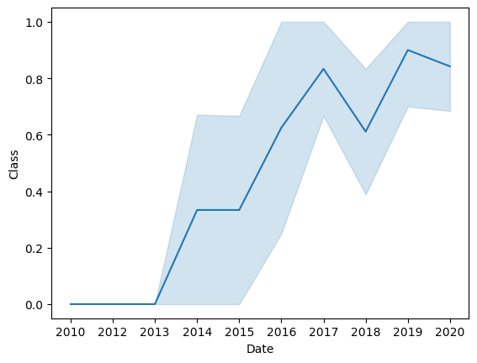
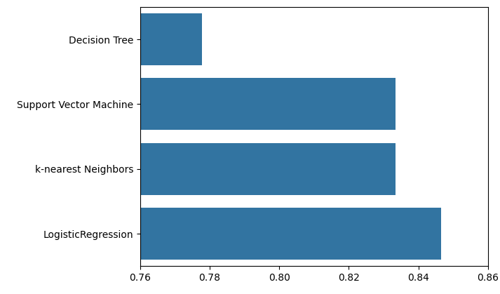
Results
Exploratory data analysis results
Interactive analytics demo in screenshots
Predictive analysis results: Best results with logistic regression

Slide 17

Section 2

Slide 18
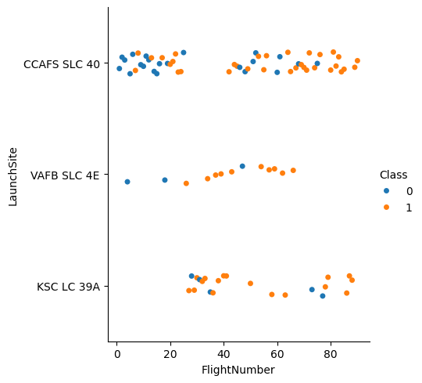
Flight Number vs. Launch Site
Flights at CCAFS SLC 40 were carried out continuously, with a short break at Flight Number ~ 40, where KSC was primarily used
VAFB seems to be discontinued, as no more flights after Flight Nr 70 are recorded
KSC started later, with no flights before Nr 20 are recorded

Slide 19
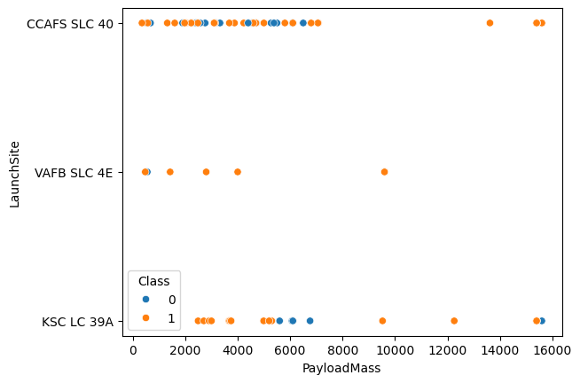
Payload vs. Launch Site
VAFB was used for less and usually smaller payloads
Most flights from CCAFS were below 8000 kg, with only 3 exceptions
KSC has a continuous range of payload mass

Slide 20
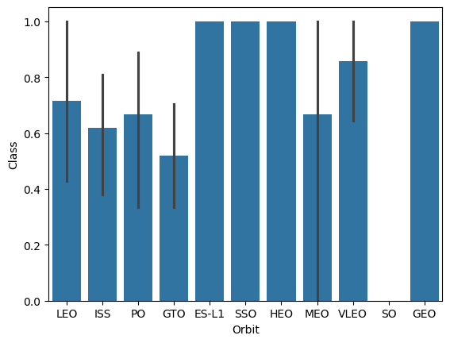
Success Rate vs. Orbit Type
The bar chart shows the success rates for different Orbit types

Slide 21
Flight Number vs. Orbit Type
The scatter plot shows, that initially only LEO, ISS, PO and GTO were targeted
Later, SSO HEO, and MEO were targeted, before focusing on VLEO
One failed SO and one successful GEO flight are also recorder

Slide 22
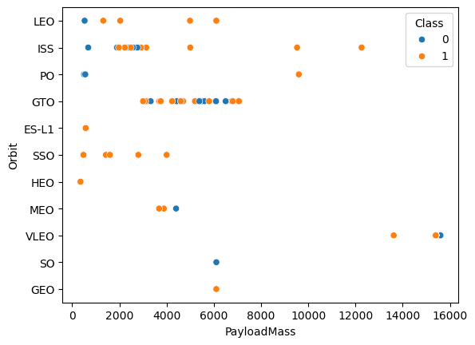
Payload vs. Orbit Type
The mission success of different Payloads for different Orbit Types are depicted in the scatterplot in the right

Slide 23
Launch Success Yearly Trend
First successes happened in 2014, that increased until 2017
2018 showed some setbacks
But 2019 and 2020 could return to success rates slightly better than 2017

Slide 24
All Launch Site Names
Find the names of the unique launch sites
SELECT DISTINCT(LAUNCH_SITE) FROM SPACEXTBL
CCAFS LC-40
CCAFS SLC-40
KSC LC-39A
VAFB SLC-4E

Slide 25
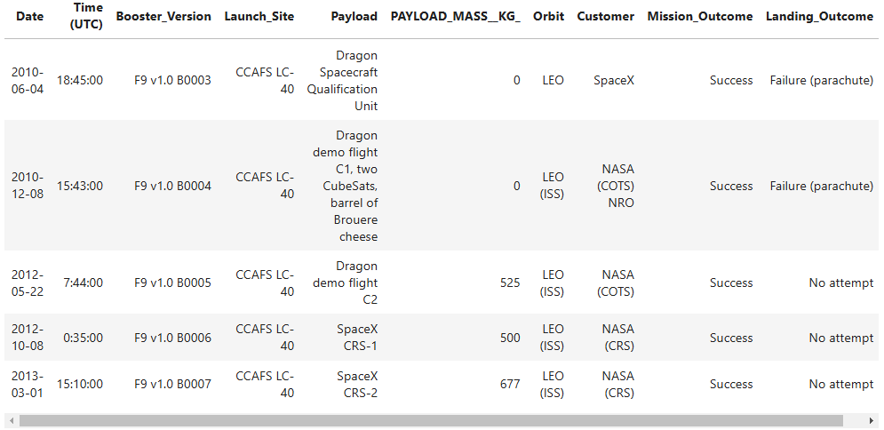
Launch Site Names Begin with 'CCA'
Find 5 records where launch sites begin with `CCA`
SELECT * FROM SPACEXTBL WHERE LAUNCH_SITE LIKE "CCA%" LIMIT 5

Slide 26
Total Payload Mass
Calculate the total payload carried by boosters from NASA
SELECT SUM(PAYLOAD_MASS__KG_) FROM SPACEXTBL WHERE CUSTOMER="NASA (CRS)“
45.596 kg

Slide 27
Average Payload Mass by F9 v1.1
Calculate the average payload mass carried by booster version F9 v1.1
SELECT AVG(PAYLOAD_MASS__KG_) FROM SPACEXTBL WHERE Booster_Version LIKE "F9 V1.1%“
2534.66 kg

Slide 28
First Successful Ground Landing Date
Find the dates of the first successful landing outcome on ground pad
SELECT MIN(DATE) FROM SPACEXTBL WHERE LANDING_OUTCOME="Success";
2018-07-22

Slide 29
Successful Drone Ship Landing with Payload between 4000 and 6000
List the names of boosters which have successfully landed on drone ship and had payload mass greater than 4000 but less than 6000
SELECT Booster_Version FROM SPACEXTBL WHERE (PAYLOAD_MASS__KG_ BETWEEN 4000 AND 6000) AND (Landing_Outcome="Success (drone ship)")
F9 FT B1022
F9 FT B1026
F9 FT B1021.2
F9 FT B1031.2

Slide 30
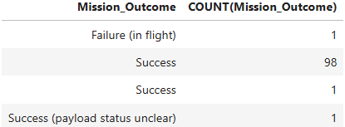
Total Number of Successful and Failure Mission Outcomes
Calculate the total number of successful and failure mission outcomes
SELECT Mission_Outcome, COUNT(Mission_Outcome) FROM SPACEXTBL GROUP BY Mission_Outcome;

Slide 31
Boosters Carried Maximum Payload
List the names of the booster which have carried the maximum payload mass
SELECT Booster_Version FROM SPACEXTBL WHERE PAYLOAD_MASS__KG_=(SELECT MAX(PAYLOAD_MASS__KG_) FROM SPACEXTBL)
F9 B5 B1048.4
F9 B5 B1049.4
F9 B5 B1051.3
F9 B5 B1056.4
F9 B5 B1048.5
F9 B5 B1051.4
F9 B5 B1049.5
F9 B5 B1060.2
F9 B5 B1058.3
F9 B5 B1051.6
F9 B5 B1060.3
F9 B5 B1049.7

Slide 32
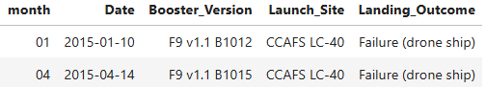
2015 Launch Records
List the failed landing_outcomes in drone ship, their booster versions, and launch site names for in year 2015
SELECT substr(Date,6,2) as month, DATE,BOOSTER_VERSION, LAUNCH_SITE, Landing_Outcome FROM SPACEXTBL WHERE Landing_Outcome='Failure (drone ship)' AND substr(Date,0,5)='2015’

Slide 33
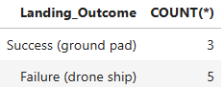
Rank Landing Outcomes Between 2010-06-04 and 2017-03-20
Rank the count of landing outcomes (such as Failure (drone ship) or Success (ground pad)) between the date 2010-06-04 and 2017-03-20, in descending order
SELECT Landing_Outcome, COUNT(*) FROM SPACEXTBL WHERE DATE BETWEEN "2010-06-04" AND "2017-03-20" GROUP BY Landing_Outcome HAVING Landing_Outcome="Success (ground pad)" OR Landing_Outcome="Failure (drone ship)" ORDER BY Landing_Outcome DESC

Slide 34

Section 3

Slide 35

Launch Sites’ location
One launch site is located close to Los Angeles
VAFB SLC-4E
The other three are close to one another in Florida:
KSC LC-39A
CCAFS LC-40
CCAFS SLC-40

Slide 36
Markers showing success of missions on map
The success of a mission is marked at each launch site
With a green marker for successful missions
With a red marker for failed missions

Slide 37
Distance from Launch Site to Ocean
Distance from Launch Site CCAFS SLC-40 to the ocean indicated by blue line

Slide 38

Section 4

Slide 39
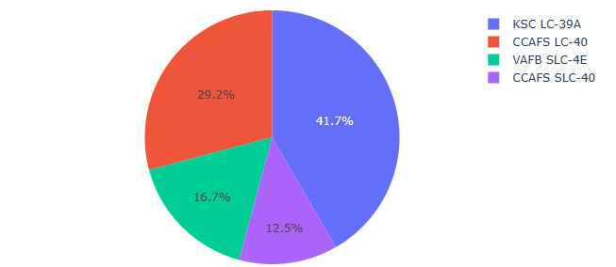
Total Successful Launches By Site
Most successful launches happen from KSC LC-39A (42%)
29% launch from CCAFS LC-40
VAFB SLC-4E (located on the west coast) attributes only to 17% of the successful launches
The remaining 13% lauch from CCAFS SLC-40

Slide 40
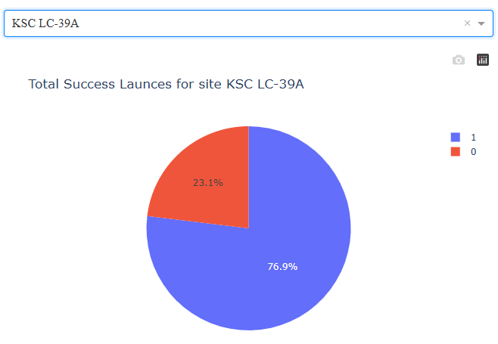
Best success rate: launches from KSC LC-39A
77% of all launches from KSC LC-39A were successful, making it the best performing launch site

Slide 41
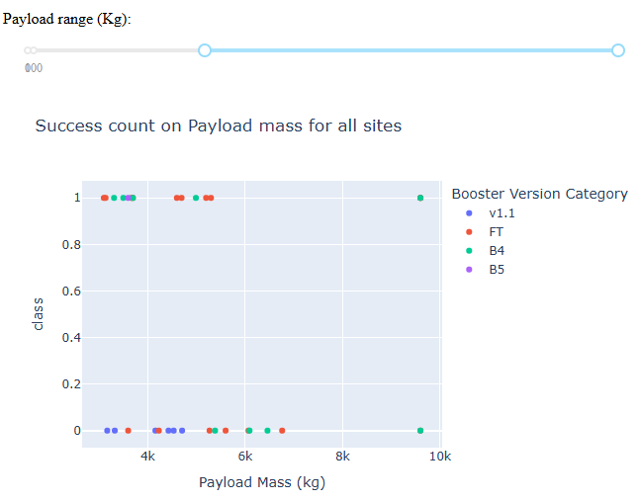
Successes of Payload-Booster combinations
Payloads between 3.000 kg and 10.000 kg are displayed
The color indicates the employed booster version
Class corresponds to success or failure of that mission

Slide 42

Section 5

Slide 43
Classification Accuracy
Among the 4 investigated models, the Logistic Regression gave the best result
Accuracy = 0.846

Slide 44
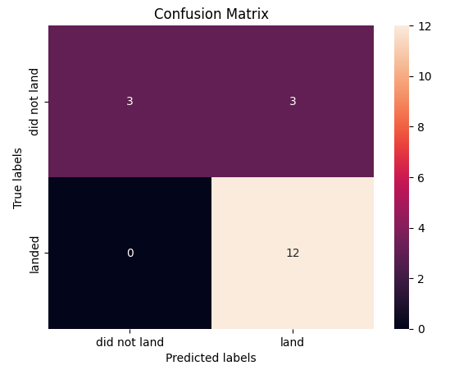
Confusion Matrix of Logistic Regression

Slide 45
Conclusions
More flights indicate a higher success rate at a launch site
Launch success rate increased from 2013 to 2020 (with a setback in 2018)
Orbits LEO, ISS, PO and GTO were targeted initially, followed by SSO, HEO, and MEO, before focusing on VLEO. Only one flight each for SO and GEO
Logistic regression gave the best results in predicting launch success

Slide 46


